Slide 1


PORTFOLIO.
BUSINESS INTELLIGENCE SPECIALIST
By Adi Setiadi
iamsetiadi88@gmail.com https://www.linkedin.com/in/adi-setiadi/

Slide 2

Table of
Content
About me Vision / mission
Personal skills Work experience
Portfolio Contact
Summary
Proven Business Intelligence & Insight Report expertise with 7,9 Years Experience at Cargill.
Advance skills in storytelling data in visualizations and deep dive insight Achieve cost potential saving ~20-30% through Accelerated Continuous Improvement as Production Excellence Adm. Coordinator at 2018~2020.
02/

Slide 3
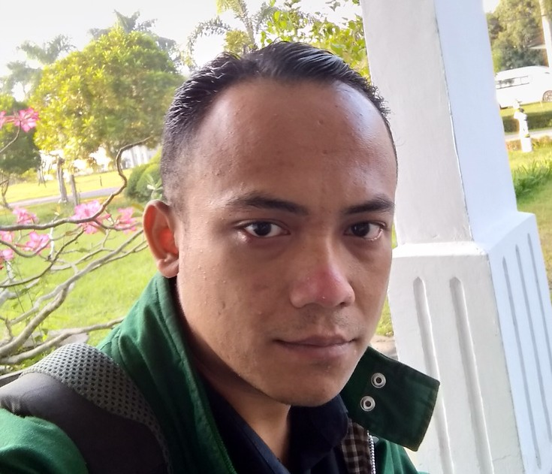
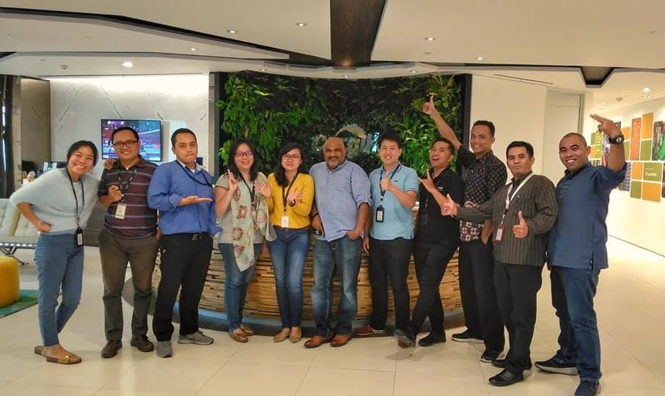
ADI
SETIADI
With my passion for data and my drive to deliver impactful solutions, I am confident in my ability to drive business success through insightful reporting
2 Yrs
8 Yrs
5 Mnth
200+
Digital Marketing Consultan
Business Intelligence Specialist
Head of Administration Management Trainee
Project
03/

Slide 4
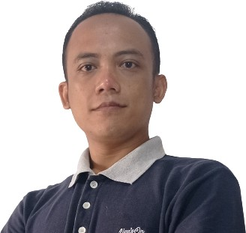
About me
ADI MULYA SETIADI
BI SPECIALIST & DIGITAL MARKETING EXPERT
I am a data-driven professional with a passion for uncovering insights and delivering impactful solutions to complex business problems
With 7,9 years of experience in data analysis, visualization and communication allows me to effectively convey complex data insights to stakeholders in a clear and concise manner
04/ ¹³

Slide 5
EDUCATION BACKGROUND
2006
2014
Management Trainee
2023
Indonesia Open University
High school
PGRI 3 CIMAHI Technical High School
Poliplant - Cargill Learning Centre
Universitas Terbuka
Electro Industry
Head of Administration Management Trainee
Bachelor of Information System

Slide 6

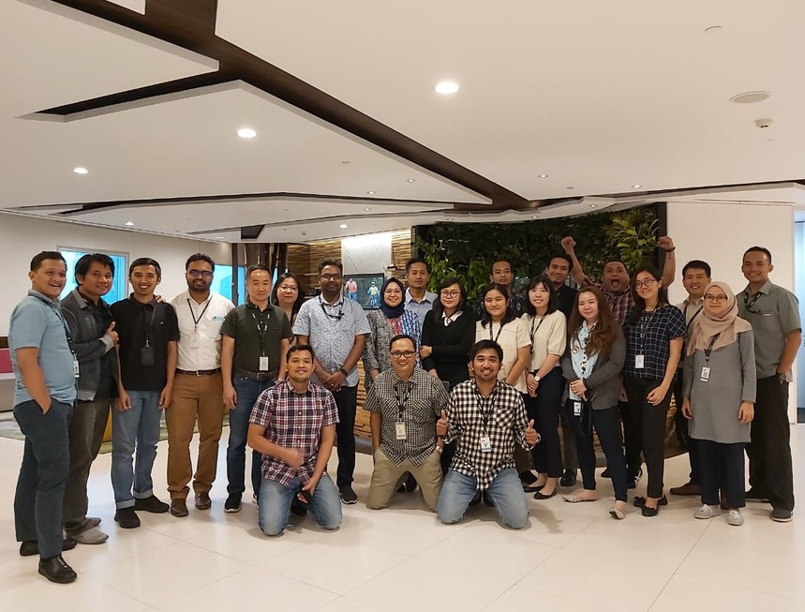

WORK
EXPERIENCE
Business Intelligence & Production Excellence Coordinator
Handling 80.000 Ha plantation management report with 19.000 labor trough sumatra and kalimantan
7.9 yrs | Cargill - Tropical Oils

Slide 7
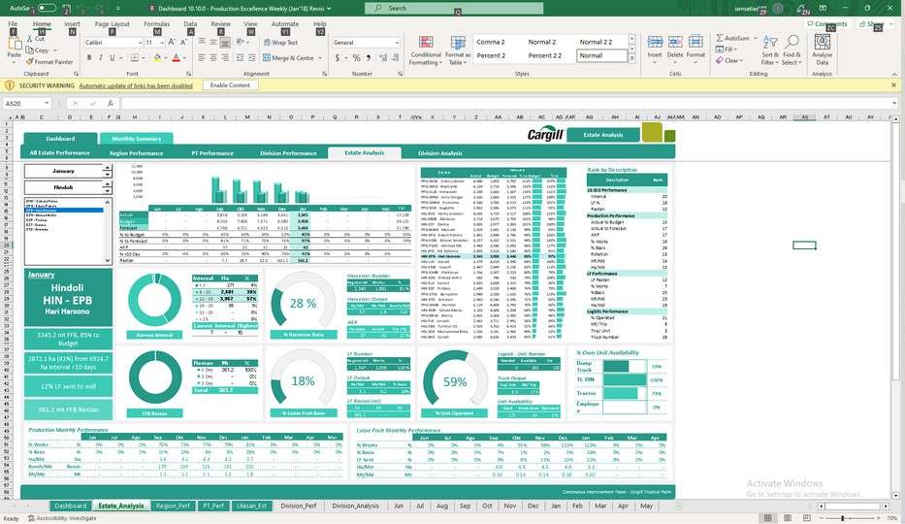
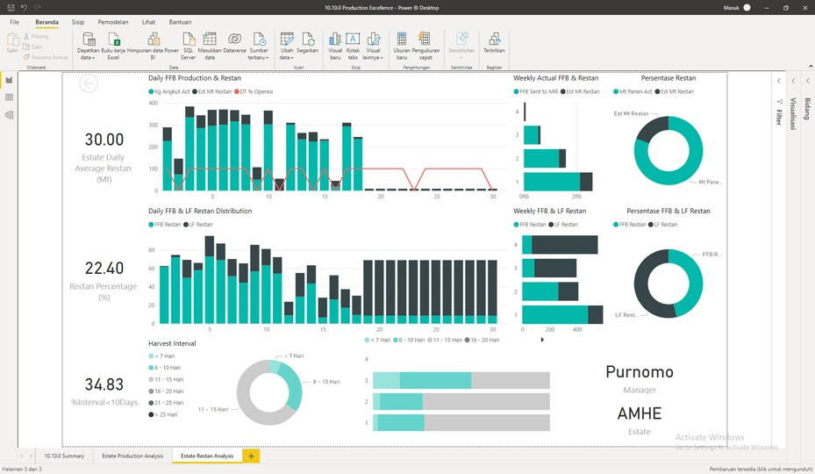
Personal
Skills
EXCEL DASHBOARD
INSIGHT (BI)
STORYTELLING DATA (PRESENTATION) PRODUCTION EXCELLENCE
PROJECT MANAGEMENT
CONTINUOUS IMPROVEMENT
POWER BI & TABLEAU

Slide 8
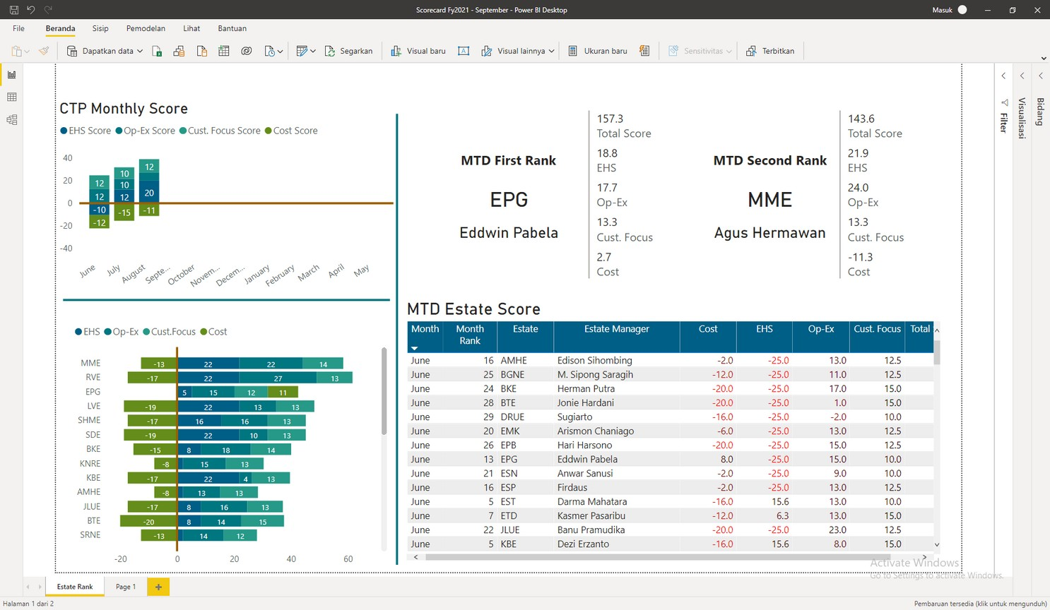

CTP Balance Scorecard - Production Excellence
Handling 30 Estate Manager ranking using balance scorecard to decide mtd to ytd Manager Ranking
PORTFOLIO
08/
13

Slide 9
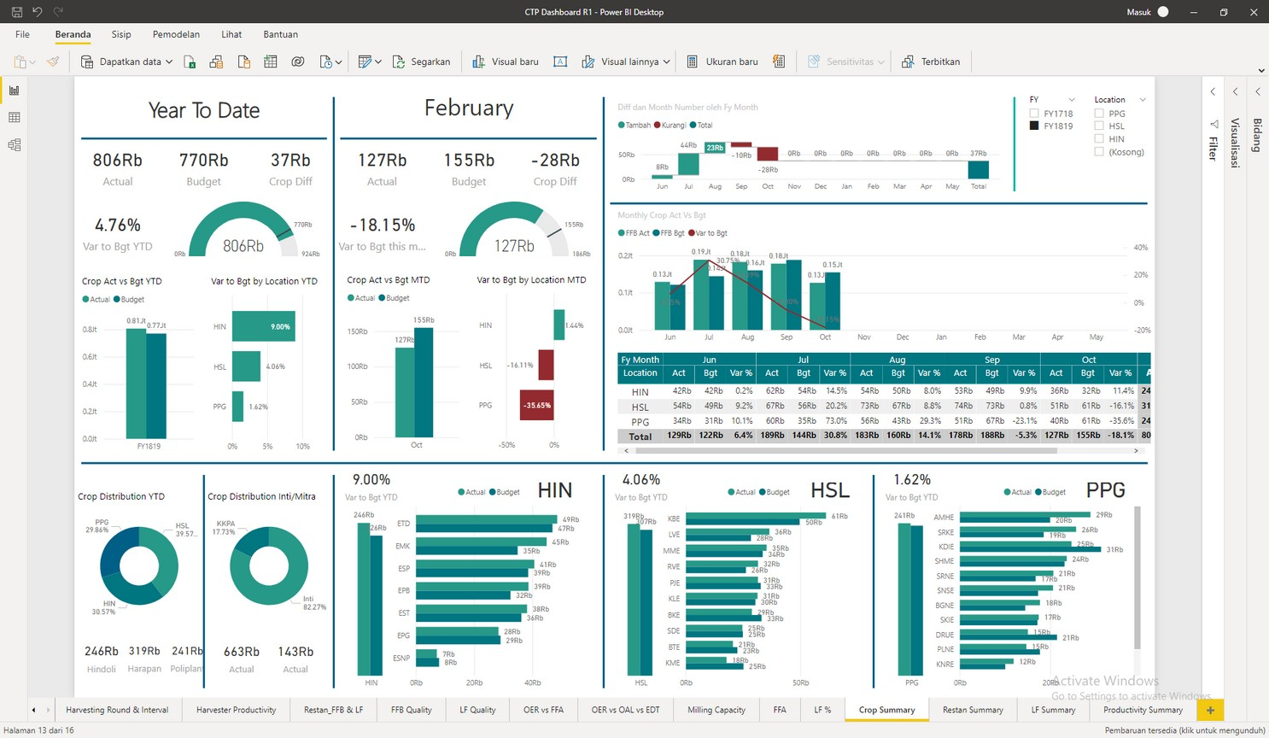

Cargill Tropical Oil
Production Management Dasboard
Describing group production report mtd to ytd
PORTFOLIO
09/
11/ ¹³
13

Slide 10
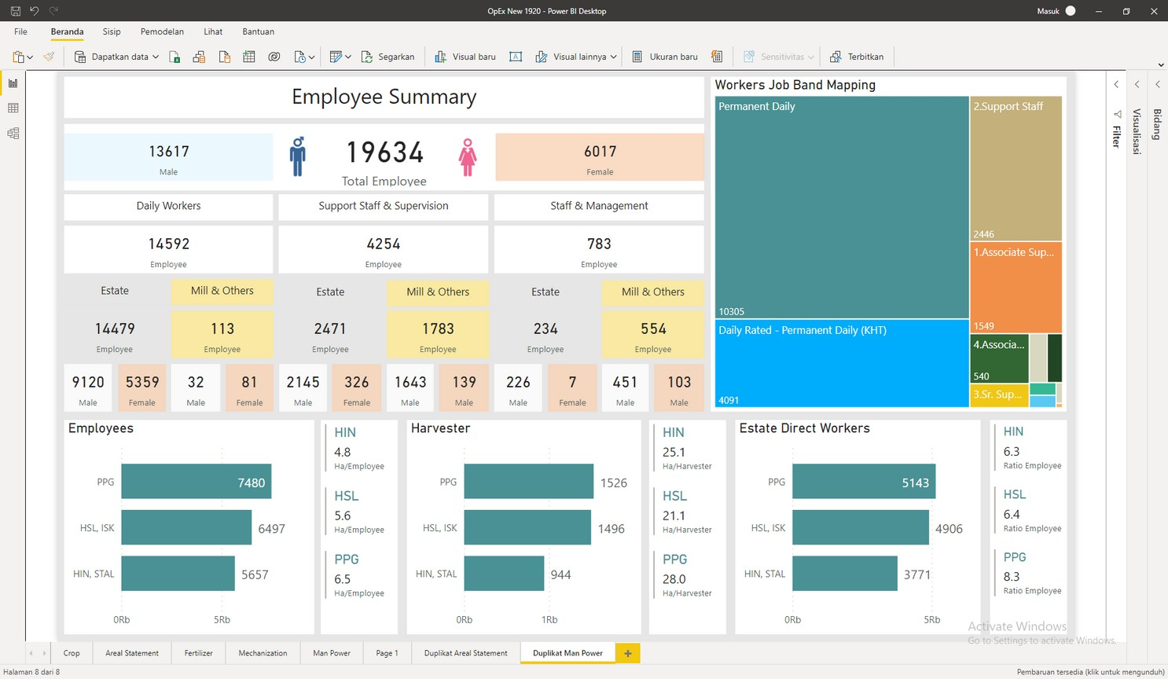
PORTFOLIO
Cargill Tropical Oils
HR Employee Mapping
Mapping ~19.000 Labor at Cargill Tropical Oil
10/

Slide 11

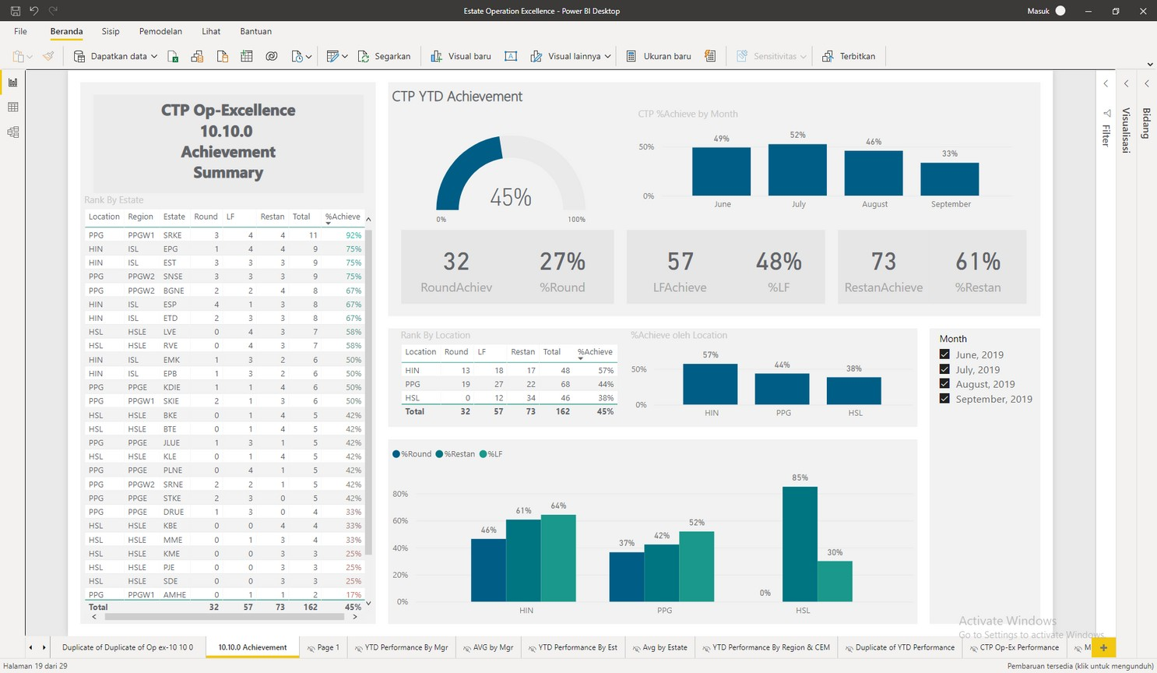
PORTFOLIO
CTP Operation Excellence - Production Excellence
Handling 30 Estate Manager ranking using Op-Excellence to decide mtd to ytd Manager Ranking
11/

Slide 12
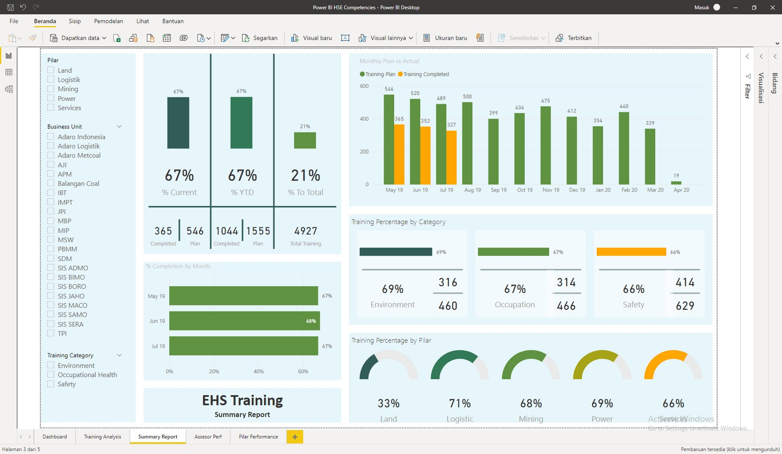
PORTFOLIO
Adaro EHS Training
EHS Training Dashboard from 5 pilar of Adaro Group to Compare and monitor Training Plan vs Actual Training Completed
12/

Slide 13
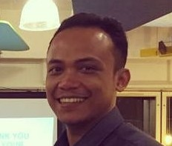
LET'S WORK
TOGETHER
MY CONTACT
+62 822 8240 8825
iamsetiadi88@gmail.com https://www.linkedin.com/in/adi-setiadi/

